Slide 1
Radio frequency identification (RFID) smart corrosion coupon
-A U.S. DOT CAAP Project
Kick-Off Meeting
Mary Kay O’Connor Process Safety Center
Chemical Engineering Department
Texas A&M University System
11/20/2013

Slide 2
Project Team
Prof. Sam Mannan
Prof. Ben Zoghi
Dr. Hao Chen
Dr. Samina Rahmani
Mr. Yizhi Hong
Mr. Brian Harding

Slide 3
Kick-off meeting purpose
Ensure that all project participants have a clear and shared understanding of project requirements and project expectations.

Slide 4
Outline
Background
  Corrosion issues
  Types of corrosion
  Types of inspection methods
Project objectives
  Advantages
  Key concepts
Project scope and approach
Project timeline and budget
Project management

Slide 5
Background
Corrosion is a staggeringly major problem across industries with cost ~$1.8 Trillion worldwide[1] and ~$276 Billion in U.S. [2]
The U.S. DOD estimated that its cost for corrosion is $22.5 billion, ~23% all maintenance costs in 2009[3]
PHMSA report shows that from 1993 to 2012, there were 1,065 significant incidents involving pipeline corrosions, causing 25 fatalities, 86 injuries, and over $650 million in property damage [4]
Corrosion effects:
  Reduced value of goods
  Reduced strength
  Equipment/production downtime
  Potential loss of containment
  Potential harm to people
Economic Losses
&
SAFETY Impact
(unexpected failures)

Slide 6
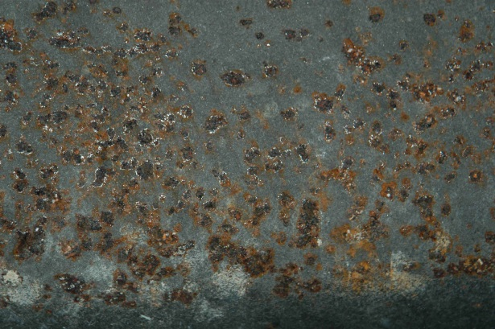
Types of corrosion
    Generalized corrosion, or uniform corrosion
  A form of corrosion that affects the entire surface of the metal, whereas other forms affect a specific spot or portion
  It results in a large volume of oxides that tend to attach themselves to the heat transfer surfaces and affect the efficiency of the system
    Pitting corrosion
The form of corrosion that occurs in isolated parts of the metal
It is concentrated to very small areas and affects the useful life of the equipment
It is localized, and harder to detect
Figure 1. Pitting corrosion

Slide 7
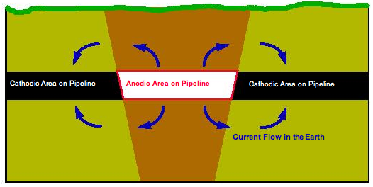
Types of corrosion (cont.)
    Galvanic corrosion
    Concentration cell corrosion
Another form of corrosion that takes place when two different metals are in contact
The presence of water with the two different metals allows corrosion to take place due to the galvanic cell action
Figure 2: Galvanized Corrosion Process
A type of galvanic corrosion that occurs when the same metal is exposed to different corrosive environments
The difference in the environment causes the metal to develop an anode region and a cathode region
Figure 3. Concentration cell corrosion

Slide 8
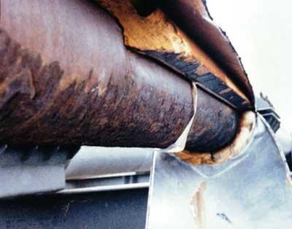
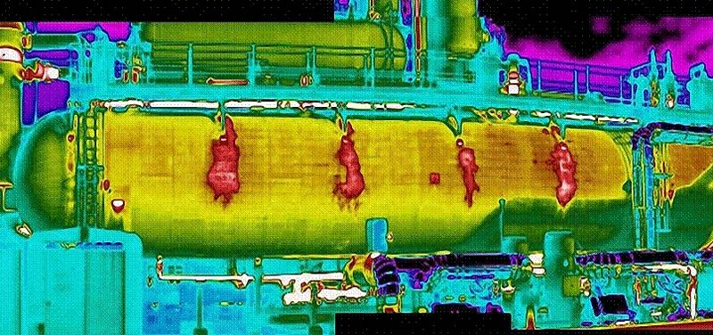
Types of corrosion (cont.)
    Corrosion under insulation (CUI)
      CUI refers to the external corrosion that takes place underneath the jacketed thermal insulation on pipes and vessels
      It is often of the pitting kind and is localized in areas that are not detected directly by inspection programs
      A main concern for modern plants
Figure 4. images of corrosion under insulation.

Slide 9
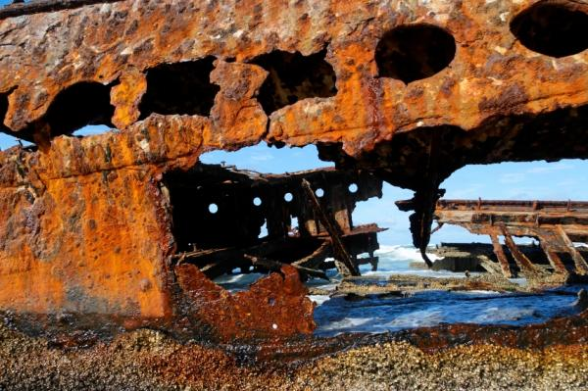
Types of corrosion (cont.)
    Crevice corrosion
      The localized corrosion that occurs at the crevice or gap between two or more joining metals (or non-metals in some cases), such as in flanges.
    Microbial corrosion
      The type of corrosion induced by the existence
      of microorganisms, including bacteria and fungi.
    Erosion/Corrosion
      A very complex type of material loss that involves both electrochemical and mechanical processes.
Figure 5. Microbial corrosion

Slide 10
Solutions for corrosion
Proper management is one major solution for the controlling and mitigating problems that stem from corrosion.
An effective inspection
  Corrosion monitoring
  Corrosion detection

Slide 11
Current inspection methods
Visual inspection
  the primary and most popular corrosion inspection method
  the most costly in terms of money and time
Ultrasonic and acoustic inspection
  utilizing high frequency sound waves above 0.2 MHz to make measurements
Radiographic inspection
  neutrons, x-rays, or gamma rays
Electro-magnetic inspection
  magnetometers and di-electrometers, superconducting quantum interference device, and magnetic flux leakage technique
Too expensive or complicated to be used as routine corrosion inspection methods.

Slide 12
Project Objective
  This project proposes to create a novel Radio Frequency Identification (RFID) smart corrosion coupon system for proper corrosion management.

Slide 13
Proposed inspection advantage
The proposed system combines the advantages of the RFID technology and the conventional corrosion coupon.
  a continuous, real-time monitoring wireless non-contact system
  inexpensive, expendable, and simple to be deployed
  universal, deployable in all ranges of conditions including environmental conditions, operating conditions, geometries, locations and materials.

Slide 14
Benefits of this project
Significantly simplify the current corrosion inspection process
Improve the accuracy and effectiveness of resources (human and equipment) available
Reduce the likelihood of having incident related to corrosion; therefore boost the overall safety performance of pipeline systems

Slide 15
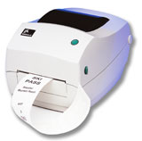




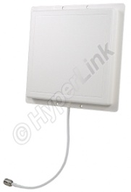
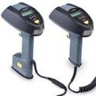
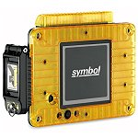
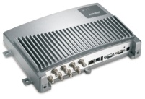
15
RFID - an verve
Printers- Applicator
Encoder
ERP
Antennas
Middleware
RFID tags
Readers
Integrated
Information
systems

Slide 16
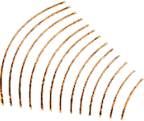


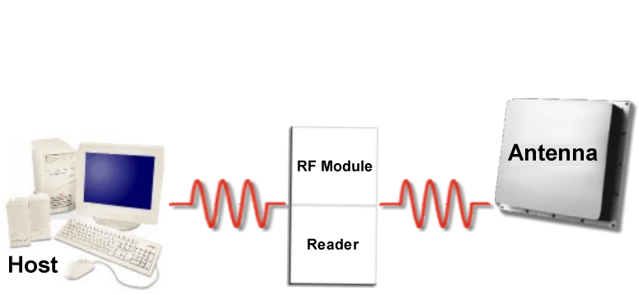
16
RFID theory of operation
Who Are You?
I am 35S4U96XE
RFID
Tag
The RFID Tag is:
  Powered by the RF Energy
  A method of uniquely identifying items using radio waves
  A reader communicates with a tag
  Used to determine “Item-Location-Time”
Notes:
The host is a computer system, which can be a personal computer, mainframe, hand held or other type of computer.
The host’s primary responsibility in this configuration is to run the software application that issues instructions to and gathers tag data from the reader/interrogator.

Slide 17
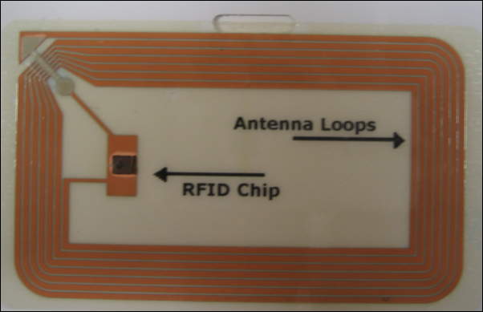
What is a smart label?
17
A paper label with RFID inside
An antenna, printed, etched or stamped…
…and a chip attached to it.
…on a substrate e.g. a plastic foil…

Slide 18


What is RFID
18
RFID (Radio Frequency Identification) is a technology that involved tags that emit radio signals and devices called readers that pick up signals
RFID tags consist of a chip for holding data and an antenna for communicating data through radio waves
The reach of RFID signals depends on the kind of chip (frequency) but is usually from several inches to 200+ feet
EPC Code
Chip
Antenna

Slide 19
RFID tag types
19
High Cost & Performance
Active Tags
  Battery powered memory, radio & circuitry
  High Read Range (up to 300 feet)
  No smart media usage
Semi-passive
  Reader activates tag, but battery powers memory
  and circuitry
  Medium Read Range (up to 50 feet)
  Smart media market beginning to emerge
Passive Backscatter
  Reader powered
  Shorter Read Range (up to 20 feet)
  Most common for smart media
ISO 18000-6B
(Intermec & Philips)
ISO 18000-6B v1.19
(Intermec & Philips)
Gen 2 (many)
Class 0, 0+ & 1 (Matrics & Alien)
Low Cost & Performance

Slide 20
Passive tag classes
20
Class | Description
0 | Passive, Read only
1 | Passive, Write once, Read many
2 | Passive, Multi Write / Read
Read/Write: Allows editing, adding information, rewriting
Read only: no possibility of editing
Other classifications : WORM, WMRM, etc.

Slide 21
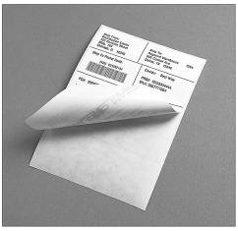
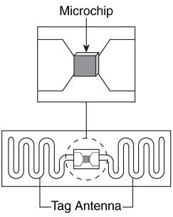
Passive transponder
21
Passive transponders are not equipped with an internal energy source (i.e. battery). They are activated and powered by a reader (the electromagnetic field activates the integrated circuit).
Notes:
Have no internal power supply
Activated by the reader
Read distances ranging from 2 millimeters through 4.6 meters

Slide 22


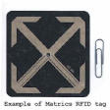
Passive transponder
22
Life cycle - theoretically infinite
Reading distance: 2mm to 4.6m
Memory: limited capacity
Less costly than the other types of chips (15¢+)
Generally used to trace objects - less valued items or in very large quantities (e.g. SCM) which require a short reading distance
low (LF), high (HF) and ultra-high (UHF) frequencies (i.e. 134KHz, 13.56MHz, 915MHz)
Multiple sizes and shapes
Notes:
Have no internal power supply
Activated by the reader
Read distances ranging from 2 millimeters through 4.6 meters

Slide 23
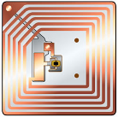
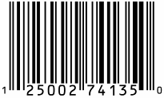
RFID vs. Barcode
23
RFID | Barcode
Electronic Device | Printed Symbol
Uses RF Waves | Uses Light
Sensitive to EMI (noise) and metal, water | Not sensitive to EMI, metal, water
Non Line-of-Sight | Line-of-Sight Required
No labor required for read | Reading requires labor, except on conveyor w/ reliable label positioning
Can be hidden, protected | Subject to dirt, abrasion, etc.
Simultaneous Read | One-at-a-time
Range: Active – 300’+, Passive 30’ | Range: 35’ if large, 2’ if small
Small to Large Data Size | Small to Medium (2D barcode) Data Size
Read/Write | Read-only
Always serialized (except EAS) | Usually not serialized
I/O to the world (sensors, computers) | No I/O
Strong Authentication possible (access control, non-duplication) | No Authentication, except encryption
$0.15 to $200+ tag, expensive reader | Virtually Free label, inexpensive reader
Emerging for some uses, Mature in other areas | Mature – Ubiquitous

Slide 24
Explosion of RFID applications
24
e-Pedigree
Variety of RFID Applications
Automatic
Toll Collection
X
Cattle ID
& Mgmt.
Container
Tracking
X
Electronic Article
Surveillance
Smart
Cards
“Friend or Foe”
Retail
Case &
Pallet
Tracking
Tracking
Rail Road
Rolling Stock
Chemical
Tracking
& Recall
X
X
Number of RFID devices
1940
1950
1960
1970
1980
1990
2000
2008

Slide 25

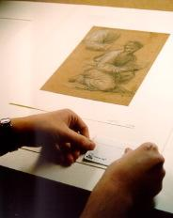
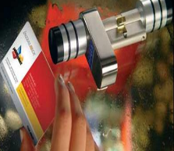
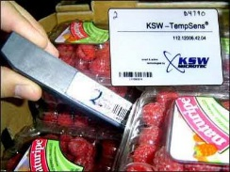
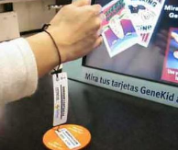
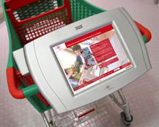
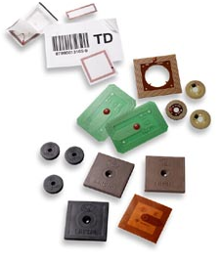
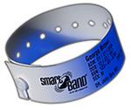
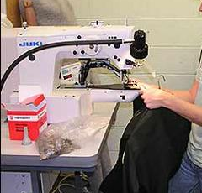
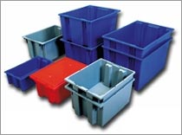
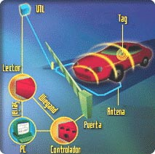


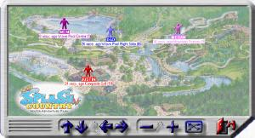
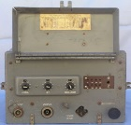
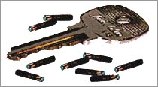
Explosion of RFID applications
25
RFID Applications Exploding
10T
1T
1B
Number of RFID devices
1M
Number of RFID devices
1940
1950
1960
1970
1980
1990
2000
2008

Slide 26
Tag price performance
26
Level of Automation
Other Satellite
GPS
Real-time locating systems (RTLS)
Two-way active RFID
Active beacon RFID
Short range passive RFID
Bar code
Very short range passive RFID
Manual entry
Cost ($)

Slide 27
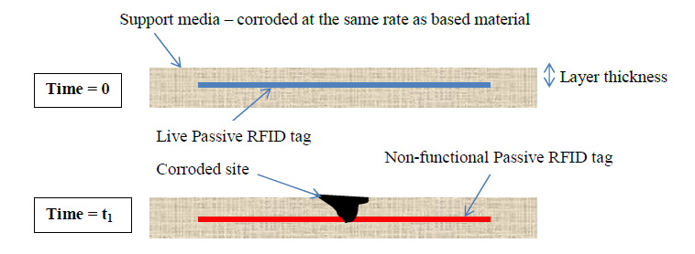
Conceptual RFID corrosion coupon
Figure 7. Conceptual design of ON-OFF single layer RFID corrosion coupon

Slide 28
Theory
Corrosion monitoring is achieved through
  a correlation between the corrodible support layer thickness, L_{T} (mm - hypothesized)
  an intrinsic property of an RFID smart corrosion coupon in a specific environment
  the percentage mass loss, P_{ML}(%), of the monitored materials in the same conditions

Slide 29
Theory (cont.)
Assumption: the time to deactivate the embedded RFID tag inside the smart corrosion coupon is negligible in comparison to the total time length of the corrosion process.
In a specific condition, the corrosion rate, R_{C-SL} of the corrodible support layer can be experimentally determined. This value, together with the known thickness, the deactivation time, t₁ of the RFID smart corrosion can be identified through:
t₁ = L_{T}/ R_{C-SL} ( Eq.1)
The deactivation time t₁, is used to identify the percentage mass loss P_{ML}, of the monitored material in the same condition using an experimentally determined correlation: P_{ML} ~ Function (t₁). (Eq.2)
From eq.1 and eq.2, we can get:
P_{ML} (%) = a* L_{T} + b (Eq.3)

Slide 30
Parameters of the RFID corrosion coupon
Material
  The supporting media materials should be the same as the material of the surfaces that need to be monitored for corrosion; however, other types of materials can also be employed.
Location
  Ideally, this smart corrosion coupon will cover the entire monitored surface or, in a more economical sense, strategic locations susceptible to corrosion.

Slide 31
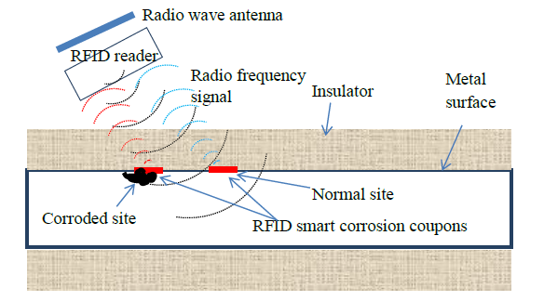
Potential application
Figure 8. Conceptual representation of using integrated radio frequency identification (RFID) corrosion coupon for corrosion under insulation.

Slide 32
Project Scope
Task 1 – RFID smart corrosion coupon design
Task 2 – Explore potential applications for areas susceptible to corrosion
Task 3 – Design laboratory corrosion testing methodology

Slide 33
Task 1 – RFID smart corrosion coupon design
The goal of this task is to develop novel types of RFID smart corrosion coupon with the following criteria:
  Passive transponder
  Small size
  Working in harsh environments with high temperature, high humidity and if possible, presence of certain corrosive species
  Having measurable and controllable corrosion rates specific to a variety of operating conditions
  Working on non-flat metal surface

Slide 34
Task 1 – RFID smart corrosion coupon design (cont.)
Design of passive RFID coupon – Embedding design
  ON-OFF RFID smart corrosion coupon
Figure 9. Conceptual design of ON-OFF single layer RFID corrosion coupon.

Slide 35
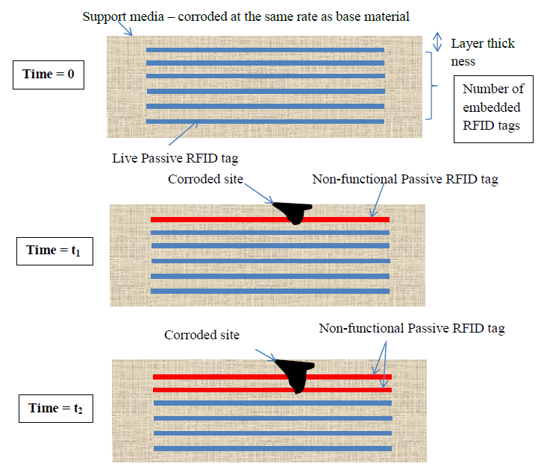
Task 1 – RFID smart corrosion coupon design (cont.)
  B. Multi-layer RFID corrosion coupon
Figure 10. Conceptual design of multi-layer RFID corrosion coupon.

Slide 36
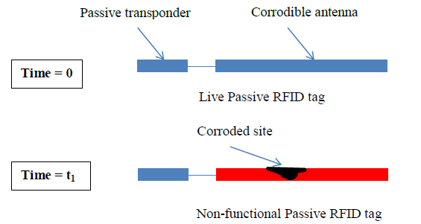
Task 1 – RFID smart corrosion coupon design (cont.)
Design of passive RFID coupon – Corrodible antenna
  The antenna of the RFID tag will be utilized directly as the corrosion coupon.
Figure 11. Conceptual design of RFID smart corrosion coupon with corrodible antenna.

Slide 37
Task 1 – RFID smart corrosion coupon design (cont.)
Important parameters:
  Different fabrication methods of RFID coupon
  Materials used to fabricate RFID coupon
  Distance for valid monitoring
  Size of RFID coupon
  Performance in harsh environment

Slide 38
Task 2 – Explore potential applications for areas susceptible to corrosion
Ideally, the RFID sensors should cover all surfaces for a complete monitoring of corrosion. However, in practice, it is possible that only certain locations which have a high probability of corrosion are selected for monitoring.
Sources:
  Literature review (journal papers, proceeding papers, patents)
  Maintenance data, corrosion inspection replacement data at the sponsoring company’s sites
  Government database/reports

Slide 39
Task 3 – Design laboratory corrosion testing methodology
The purpose of the corrosion testing methodology is to identify a set of material as corrodible support medium for the RFID smart corrosion coupon design and to test their corrosion rates.
The results from corrosion testing will help establish the relationships between the thickness of RFID smart corrosion coupons and the percentage mass loss for a range of materials in specific conditions.
These relationships will be employed as coupon selection guidance so that the proper type of RFID coupons can be used.

Slide 40
Task 3 – Design laboratory corrosion testing methodology (cont.)
Experimental plan:
  A simple experiment to test the validity of RFID corrosion coupon
    A piece of iron pipe is immersed into corrosive liquid with RFID coupon attached on surface
    Another identical piece of iron pipe is well insulated to prevent corrosion with RFID coupon attached on surface (control group)
  Well controlled corrosion process in a corrosion testing chamber
    Temperature, humidity, etc.

Slide 41
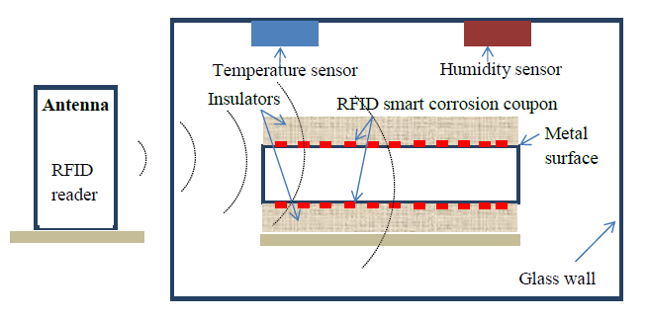
Corrosion testing chamber
Figure 12. Conceptual corrosion testing chamber for testing RFID smart corrosion coupon

Slide 42
Task 3 – Design laboratory corrosion testing methodology (cont.)
Parameters to collect:
  Validity of RFID corrosion coupon
  Different design of RFID corrosion coupon
  Performance of RFID corrosion coupon under different corrosion types and environmental condition
  Corrosion rate based on different environmental conditions
  Validation of equation 3: P_{ML} (%) = a* L_{T} + b

Slide 43
Project timeline and budget
Timeline
Budget
  Total budget for this project is $142,861. Support from US Department of Transportation is $99,512; cost share from Texas Engineering Experiment Station is $43,349.
Time schedule for tasks | 2014-Q1 (Jan-Mar) |  |  | 2014-Q2 (Apr–Jun) |  |  | 2014-Q3 (Jul-Sep) |  |  | 2014-Q4 (Oct-Dec) |  |  | 2015-Q1 (Jan-Mar) |  |  | 2015-Q2 (Apr-Jun)
Task 1 – RFID smart corrosion coupon design
Task 2 – Explore potential applications for areas susceptible to corrosion
Task 3 – Design laboratory corrosion testing methodology

Slide 44
Future development
Results from this project will create a foundation for the future development of using RFID technology in corrosion control.
Future applications could include smart piping systems, smart components in which RFID tags are embedded inside either as corrosion coupons or as corrosion sensors to detect the presence of a corrosive environment such as excessive level of moisture, water, corrosive species, or the presence of corrosion products such as iron oxide and then transmit the signal through the RFID tags.

Slide 45
Project management
Meetings
  Monthly meeting with Prof. Sam Mannan
  Weekly meeting with Prof. Ben Zoghi
  Weekly meeting with Dr. Hao Chen and Dr. Samina Rahmani
  Meeting with Ms. Julie Halliday and other experts
Report
  Quarterly stage report
  Mid-term report and final report
Project Safety Analysis (PSA)

Slide 46
References
Günter Schmitt, Global Needs for Knowledge Dissemination, Research, and Development in Materials Deterioration and Corrosion Control, Whitepaper of The World Corrosion Organization, 2009. http://www.corrosion.org/images_index/whitepaper.pdf
NACE International Corrosion Society, Corrosion Costs and Preventive Strategies in the United States. http://www.nace.org/uploadedFiles/Publications/ccsupp.pdf
Eric Herzberg, The annual cost of corrosion for DOD, 2009 DOD Corrosion conference. https://www.corrdefense.org/Technical%20Papers/THE%20ANNUAL%20COST%20OF%20CORROSION%20FOR%20DOD.pdf
U.S. Department of Transportation, Pipeline and Hazardous Materials Safety Administration, Significant pipeline incident statistic from 1993 to 2012. http://primis.phmsa.dot.gov/comm/reports/safety/SigPSIDet_1993_2012_US.html?nocache=427

Slide 47

Questions and Comments

