Slide 1
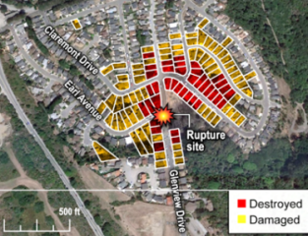
Land Use and Development Planning near Transmission Energy Pipelines
~ North Dakota~
Jan. 15, 2013
~ Impact Area , Natural Gas Transmission Pipeline Explosion
San Bruno, CA

Slide 2
Agenda
Introductions
Energy Pipelines 101
Energy Pipelines in North Dakota
Why are pipelines important?
Who regulates pipeline safety?
Roles local governments can play in pipeline safety?
Land planning near pipelines
Emergency response
Excavation damage prevention
Hazard mitigation planning
PIPA recommended practice examples
Resources for local governments

Slide 3
Energy Pipelines 101

Slide 4
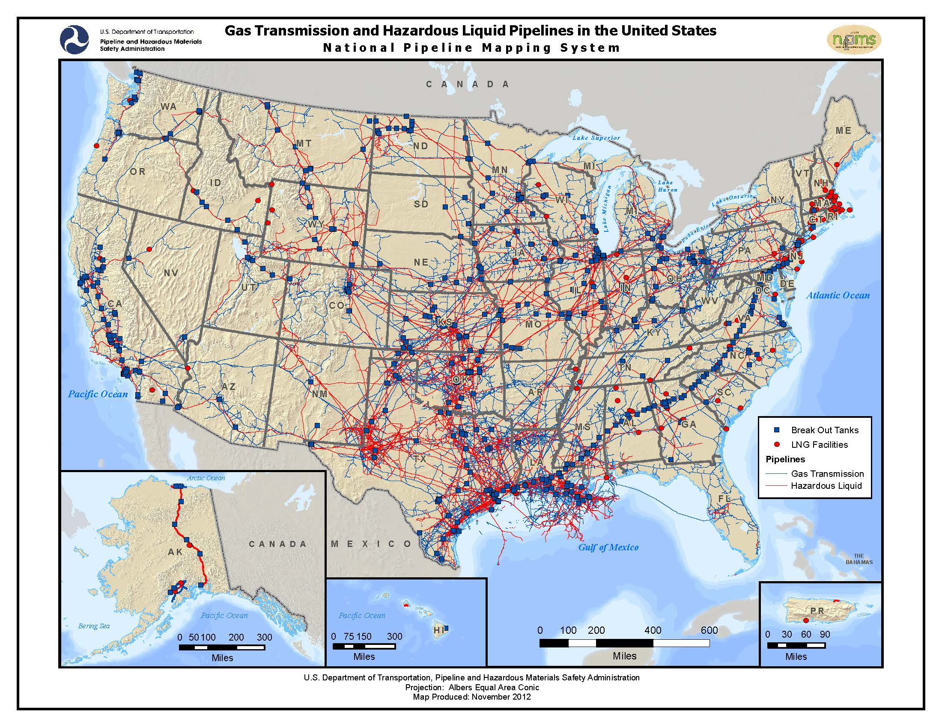

Slide 5
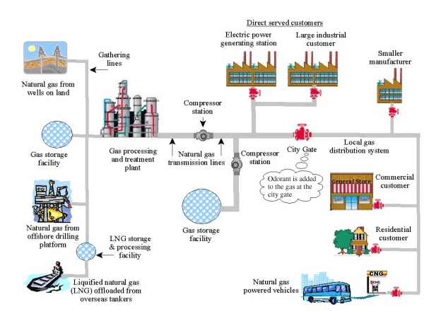
Natural Gas Pipeline Systems:
From the Wellhead to the Consumer

Slide 6
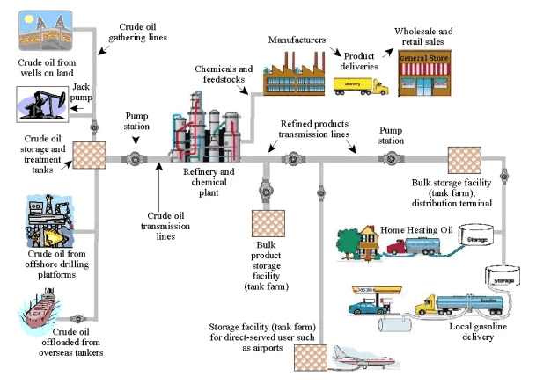
Petroleum Pipeline Systems:
From the Wellhead to the Consumer
HL products transported:
Gasoline
Diesel fuel
Kerosene
Natural gas
Heating oil
Propane
Aviation gasoline.
Jet fuel
Carbon dioxide (CO₂)
Ethane
Crude oil
Coal
Liquefied natural gas (LNG)
Coal slurry

Slide 7
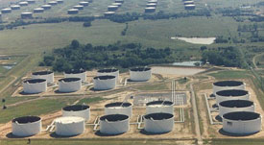
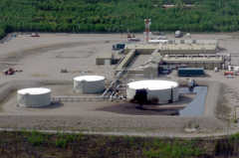
Pump Station & Tank Farm

Slide 8
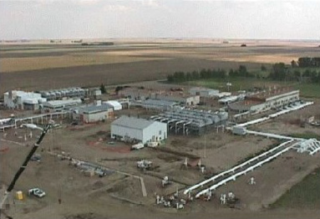
Compressor Station

Slide 9
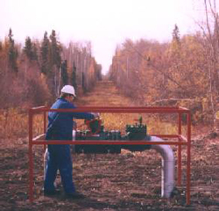
Valves

Slide 10
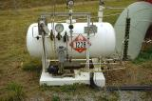
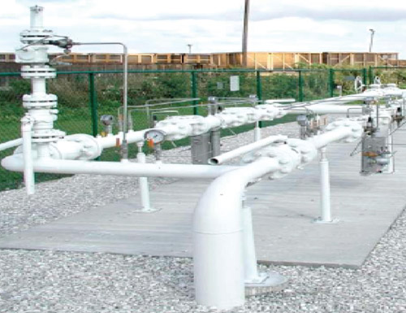
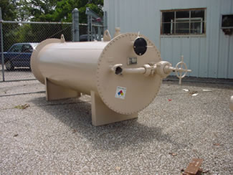
City Gate Station
Odorant Tank
Meter and Regulator Runs
Line Heater

Slide 11
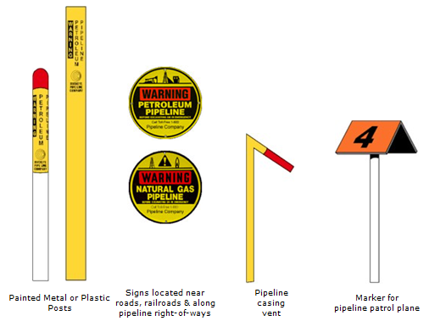
Identifying Pipelines in The Field
Provides an indication of their presence (not exact location), product carried and the name and contact information of the company that operates the pipeline.
Pipeline markers are generally yellow, black and red in color.

Slide 12
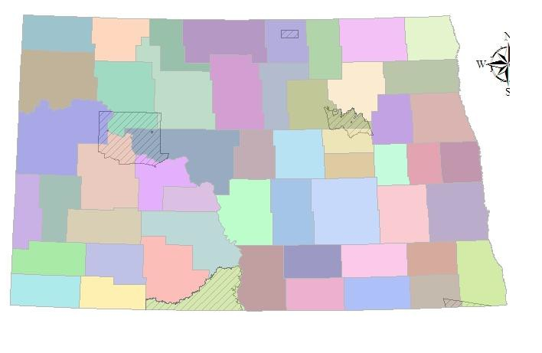
Energy Pipelines in North Dakota

Slide 13
http://northdakotapipelines.com/maps/
https://www.dmr.nd.gov/pipeline/assets/pdf/05202010/2010%20ND%20Natural%20Gas%20Report.pdf

Slide 14
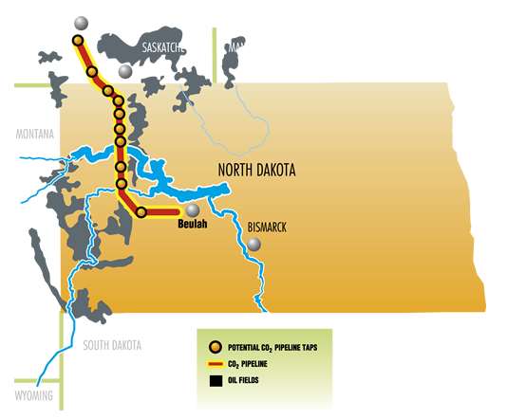
http://www.dakotagas.com/Gas_Pipeline/CO2_Pipeline/index.html

Slide 15
http://northdakotapipelines.com/maps/

Slide 16
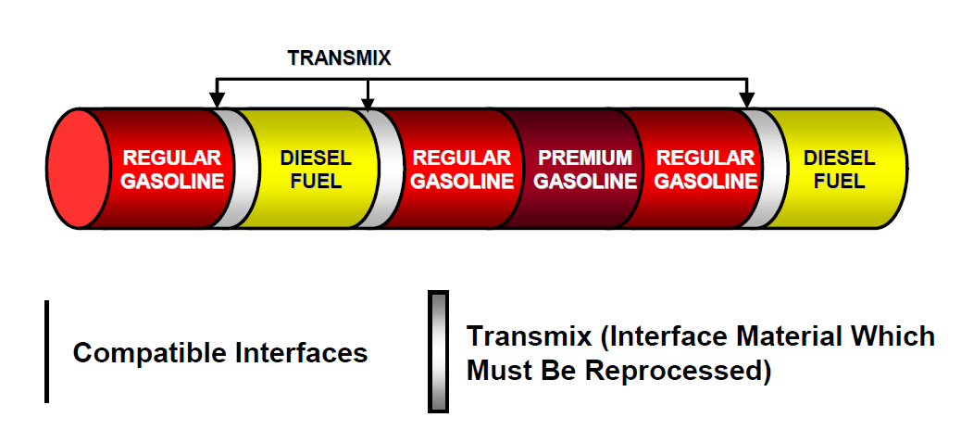
Typical Sequence of Petroleum Products Flow Through A Pipeline

Slide 17
http://northdakotapipelines.com/maps/

Slide 18
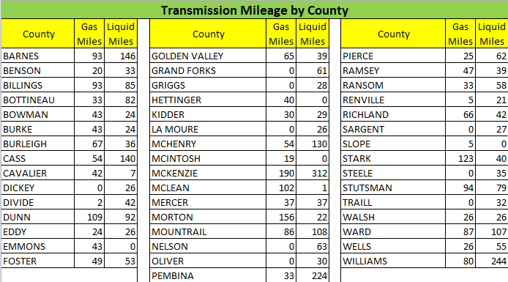
ND Transmission Pipeline Mileage by County
http://primis.phmsa.dot.gov/comm/reports/safety/ND_detail1.html

Slide 19
Why Are Pipelines Important? Benefits and Risks

Slide 20
Benefits and Risks of Pipelines
Benefits
Safe, secure, cost efficient transportation
Fuel for:
Motor vehicles, ships and airplanes
Heating, water heat, cooking, drying
Commercial – Bakery, dry cleaner, generators
Industrial – glass and aluminum manufacturing
Agricultural – corn dryer
Power plants
Military – largest single buyer in the world
Feedstock for food products, pharmaceuticals, plastics and resins
Risks
Life Safety (health effects, injury, fatality)
Environmental
Property Cultural/historical
Economic disruption or cessation
Loss of confidence in government/operator
Fear

Slide 21
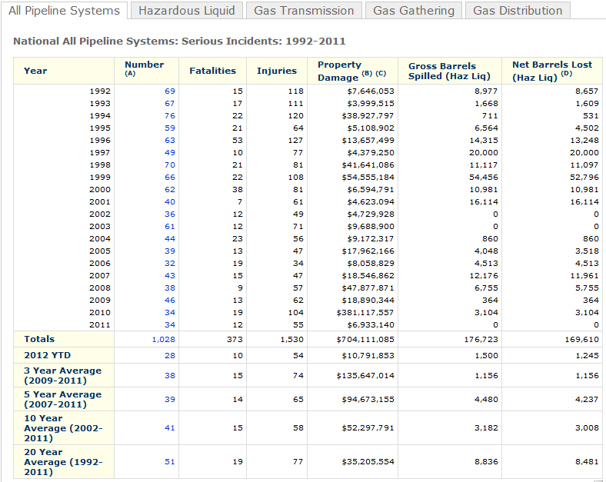
Serious Pipeline Incidents Nationally

Slide 22
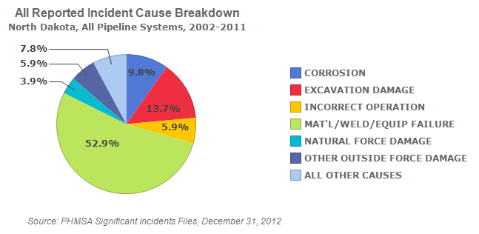
Pipeline Failures – Causes
http://primis.phmsa.dot.gov/comm/reports/safety/ALLPSIDet_2002_2011_ND.html?nocache=6656#_all

Slide 23
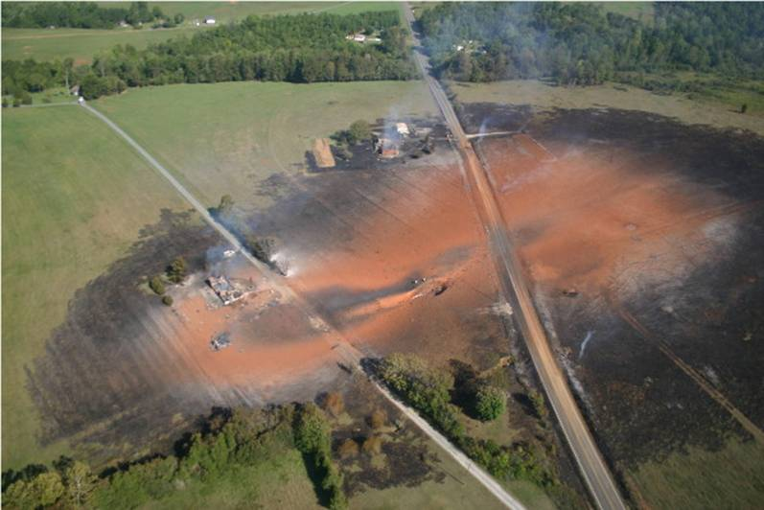
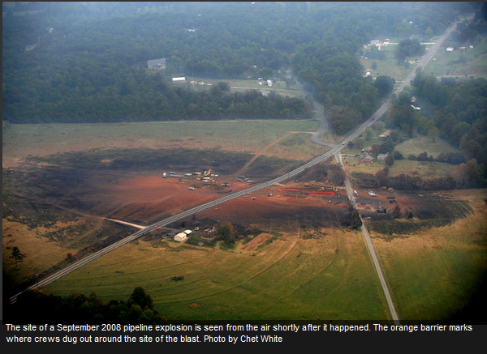
Pipeline Failures – Gas Transmission
Appomattox, VA

Slide 24
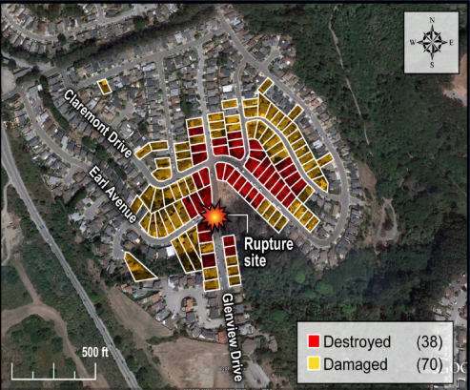
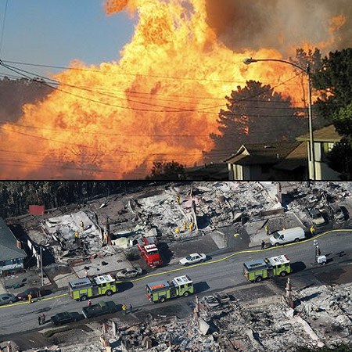
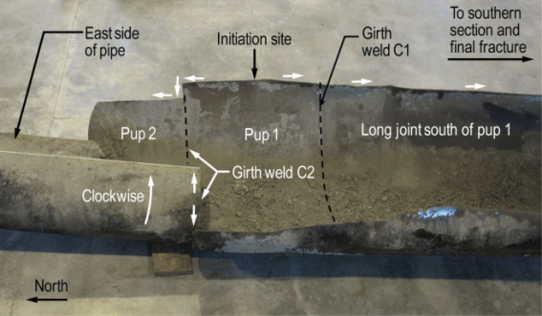
Pipeline Failures – Gas Transmission
Natural gas transmission pipeline fire in San Bruno, CA.

Slide 25
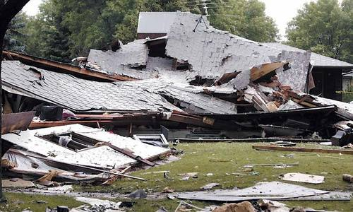
Pipeline Failures - Natural Gas Distribution
Natural gas distribution explosion, Sept. 2, 2008 Fargo, ND.

Slide 26
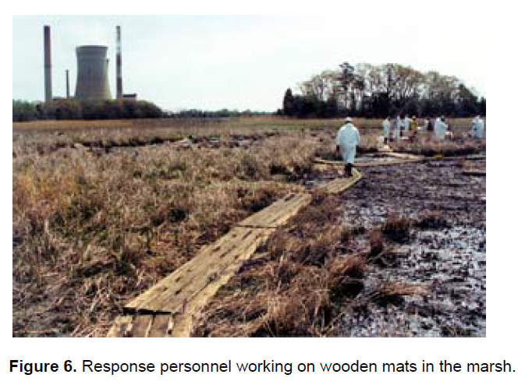
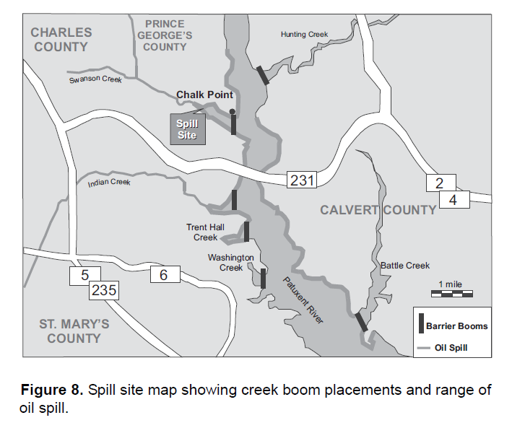
Pipeline Failures – Hazardous Liquid

Slide 27
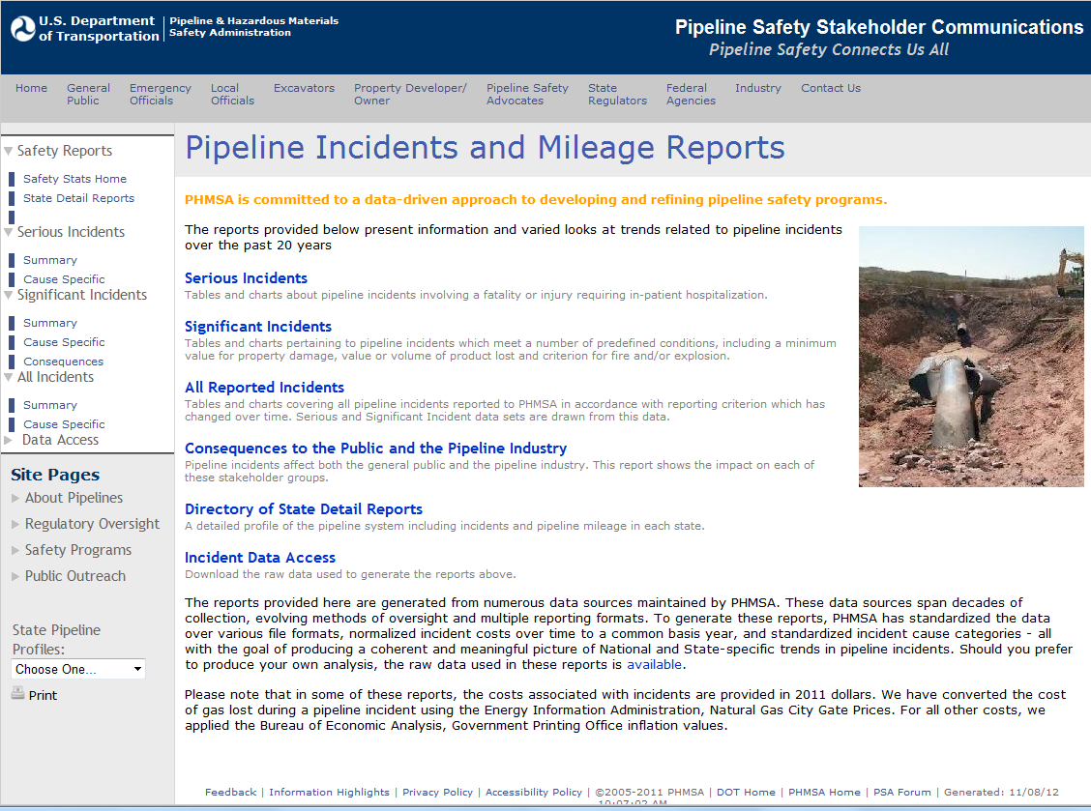
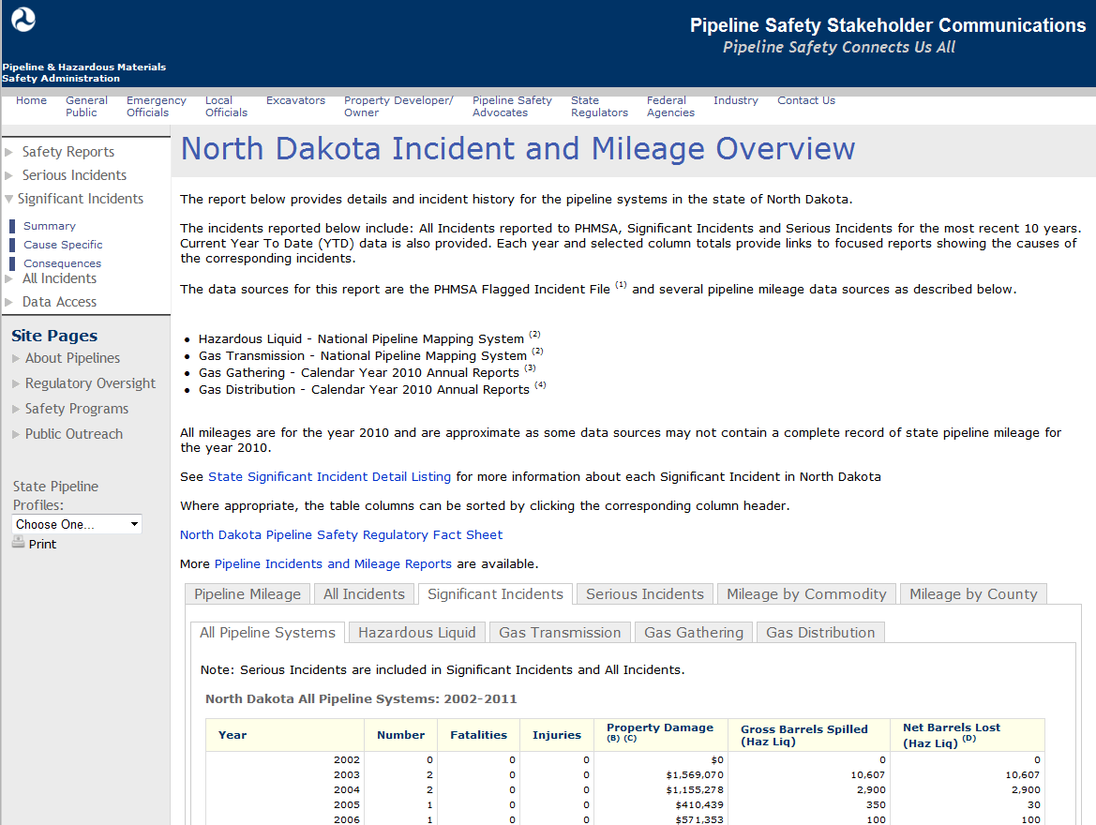
National and Jurisdiction-Specific Pipeline Risk
primis.phmsa.dot.gov/comm

Slide 28
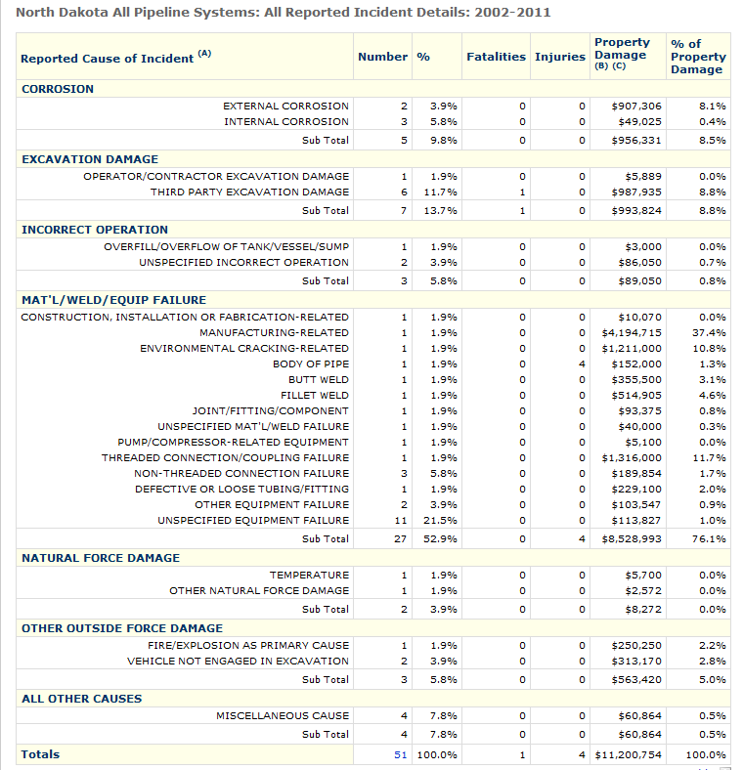
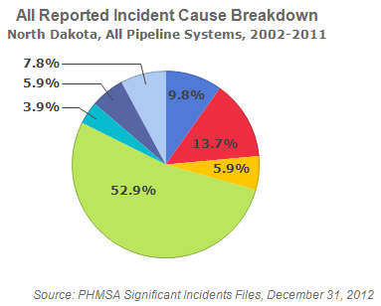
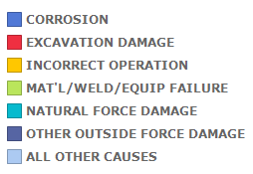
North Dakota - All Pipeline Incident Statistics

Slide 29
Who Regulates Pipeline Safety?

Slide 30
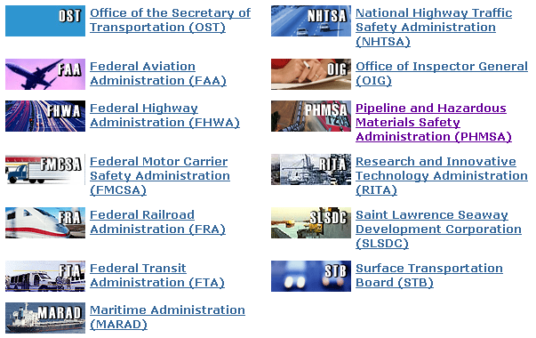
Who regulates pipelines…Federal
Office of Pipeline Safety
Hazardous Materials Safety

Slide 31
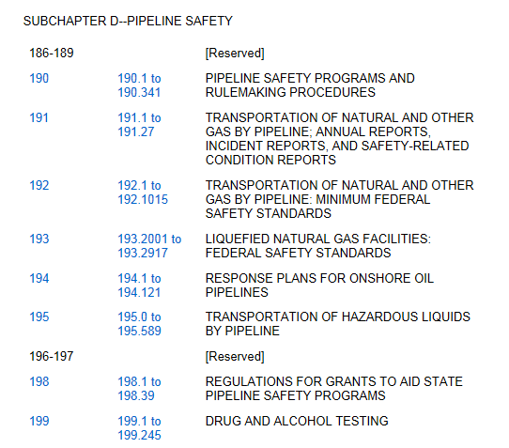
Code of Federal Regulation Pipeline Safety - Title 49 Part 190 - 199

Slide 32
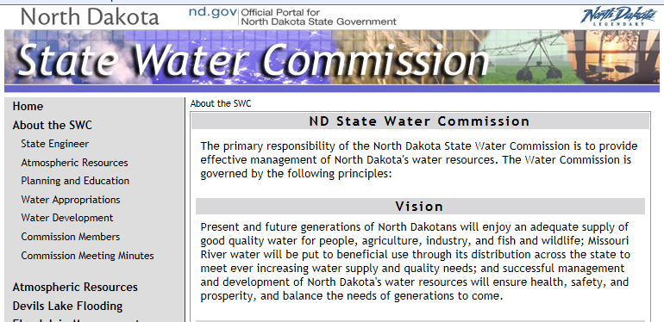
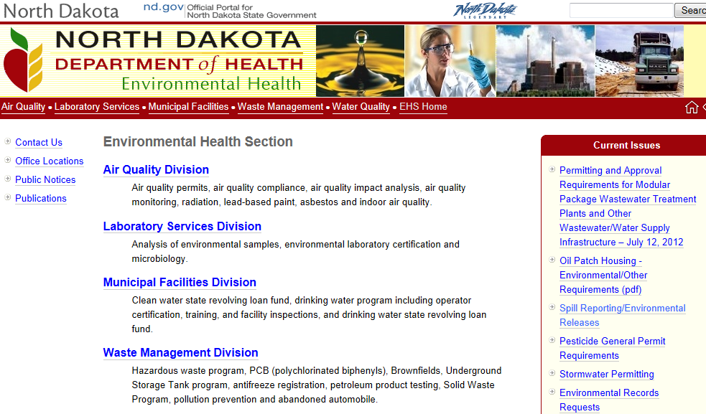
North Dakota Pipeline Safety Regulation

Slide 33
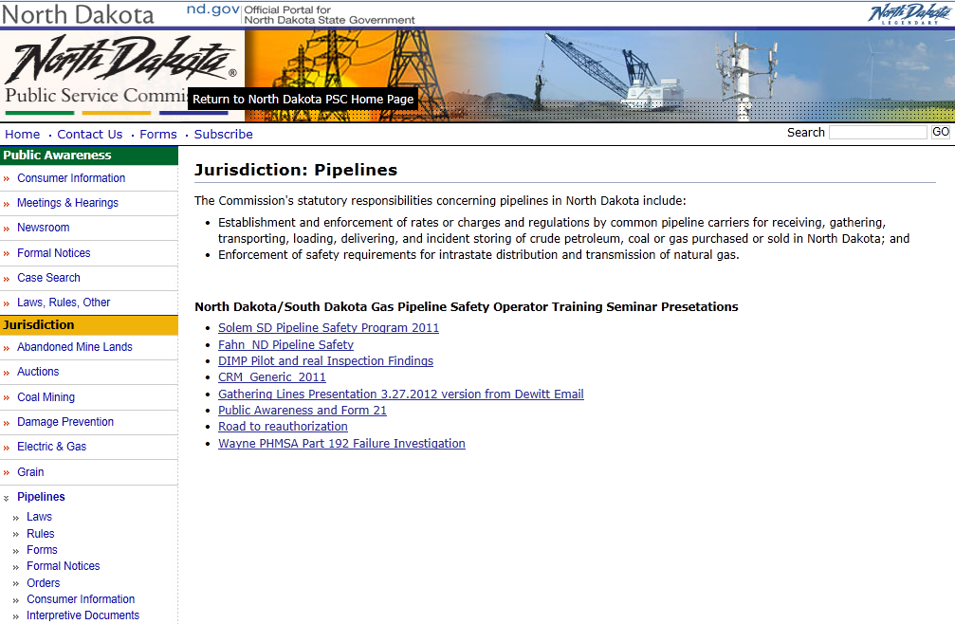
North Dakota Pipeline Safety Regulation

Slide 34
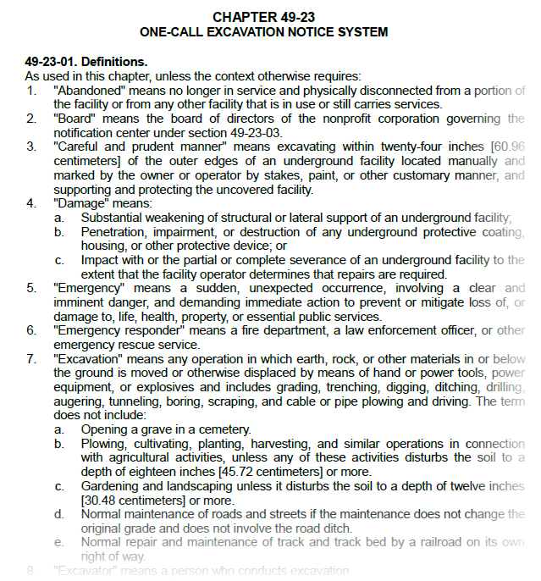
North Dakota Pipeline Safety & Excavation Damage Prevention Codes
North Dakota pipeline safety codes are equivalent to the Federal codes.
Excavation Damage codes are under Chapter 49-23 One-call excavation notice system

Slide 35
State & Local Government Role in Pipeline Safety
Public Awareness of Pipelines
Excavation Damage Prevention
Emergency Preparedness, Response, & Recovery
Land Use and Development Planning Authority…

Slide 36
Pipeline Safety & Land Planning Authority

Slide 37
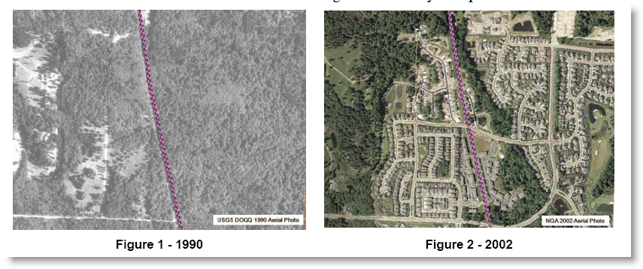
Growth along a transmission pipeline in Washington State…
1990
2002

Slide 38
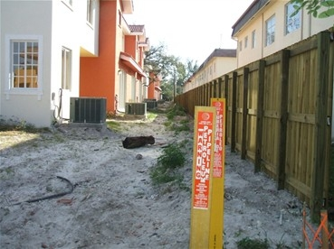
Growth Near the Pipeline ROW

Slide 39
Limit the negative impacts of land development near pipelines…

Slide 40
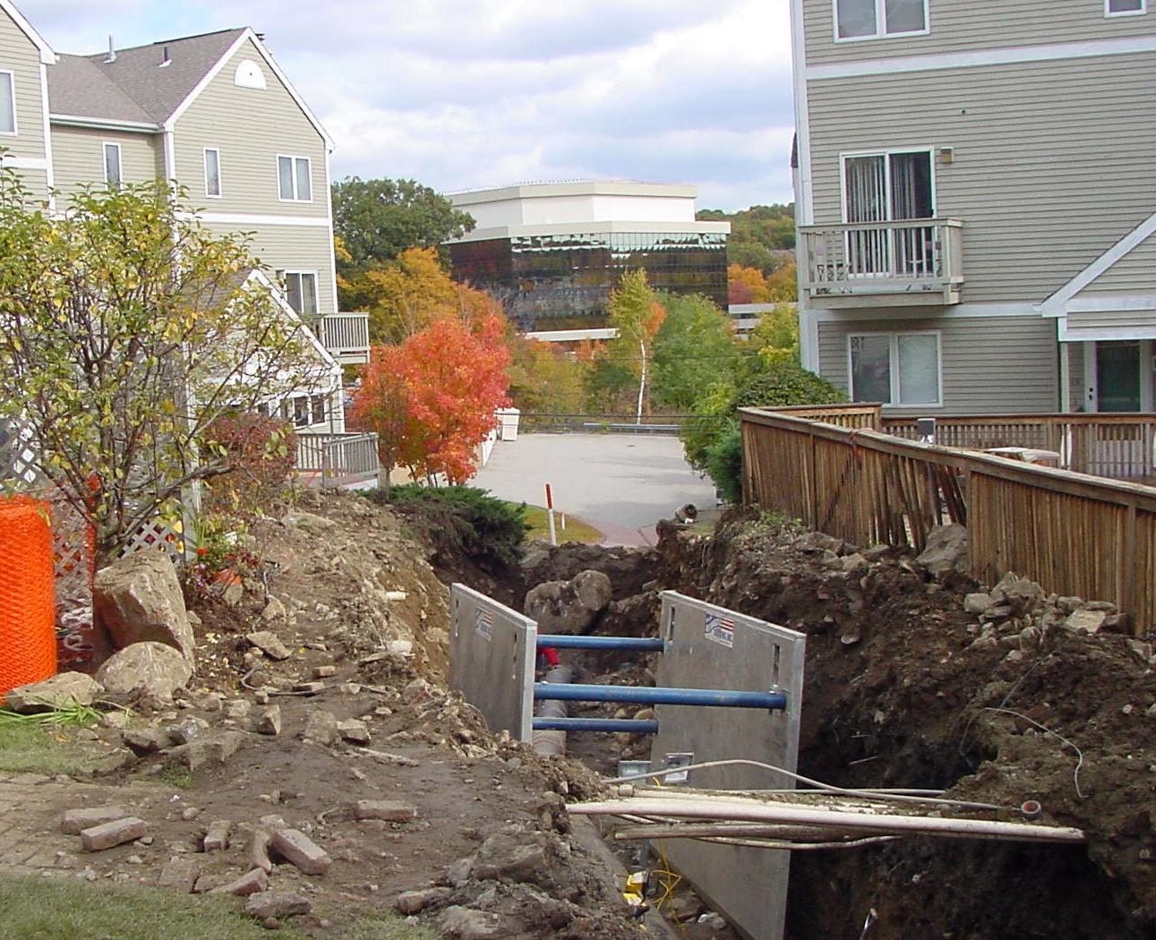
Increases Likelihood of Excavation Damage
Impedes Access for Emergency Response & Safe Maintenance/Operation of the Pipeline

Slide 41
Increased Consequences of Failure

Slide 42
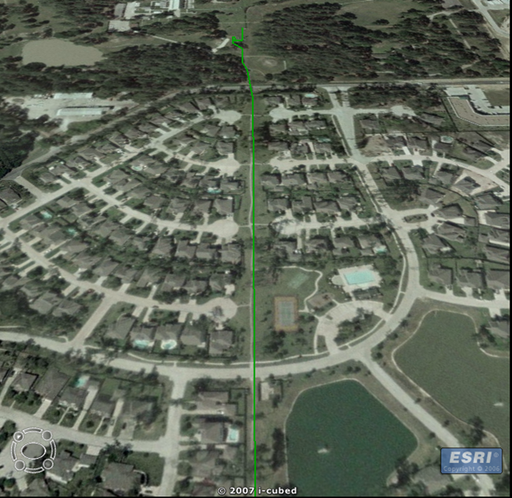
Choosing Better Options

Slide 43
About the PIPA Report
Created by a stakeholder group of ~130 participants representing a wide range of interests, organizations, and viewpoints on pipelines and community planning.
Scope: Existing Gas Transmission & Hazardous Liquid Pipelines
Stakeholders: Local Government, Property Developer/Owner, Pipeline Operator, Real Estate Commission
Scenarios: Baseline (implement in preparation for future) and New Development (Implement when use/development is proposed)
43 Recommended Practices
www.PIPA-Info.com
Notes:
43

Slide 44
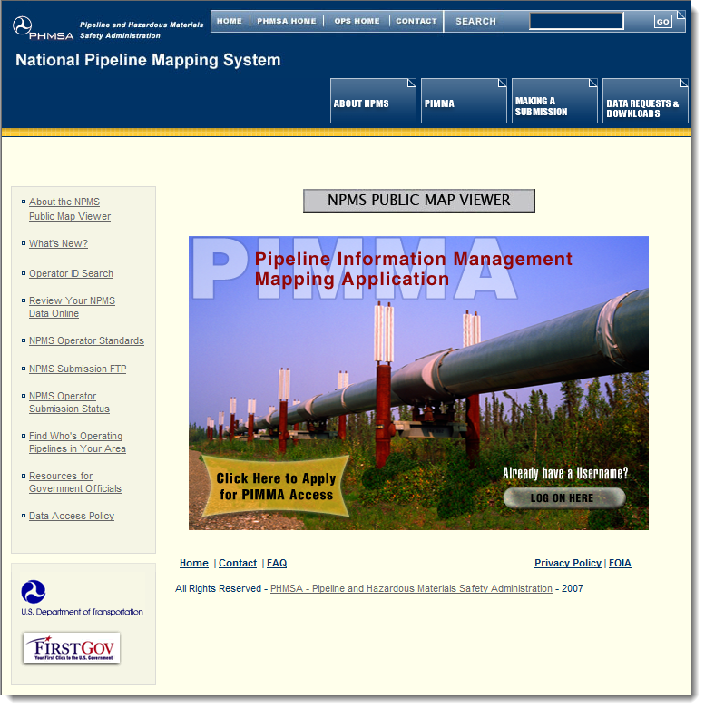
BL01 Obtain Transmission Pipeline Mapping Data
Obtain Transmission Pipeline Mapping Data

Slide 45
Incorporate Pipeline Maps on Internal GIS Maps

Slide 46
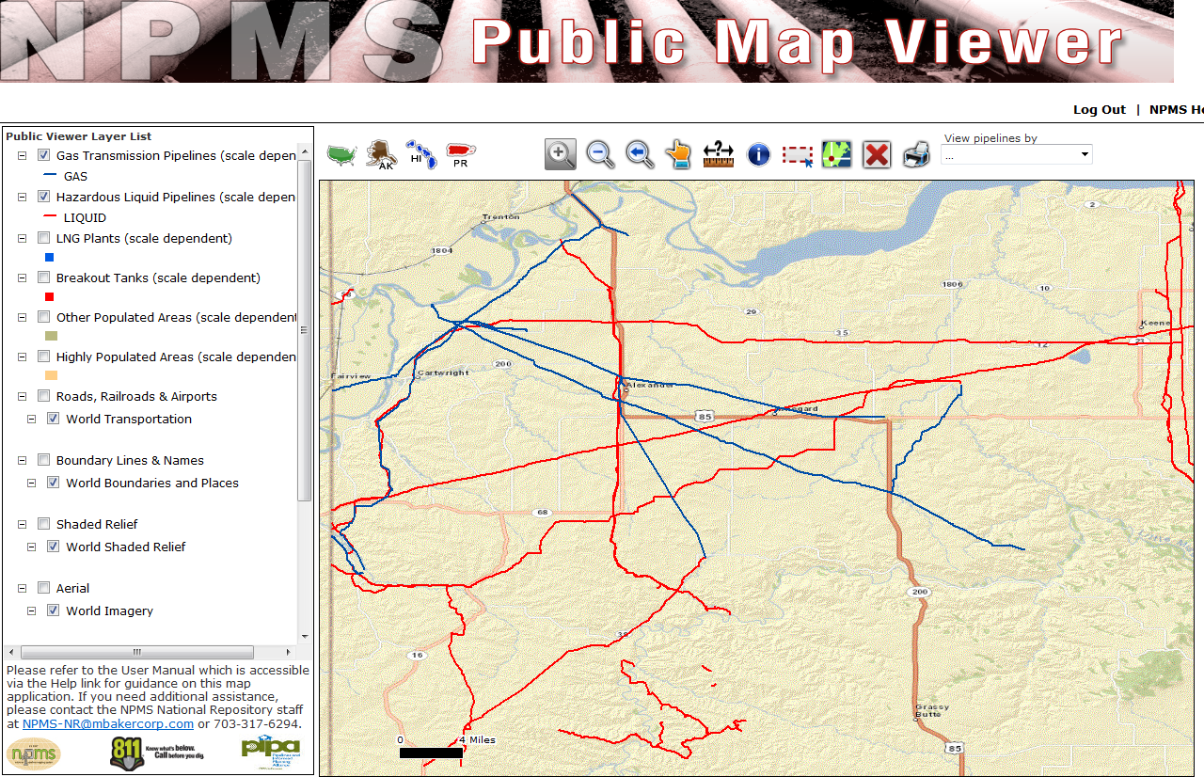

Slide 47
BL05 – Consultation Zone
Local governments should define a “consultation zone” to provide a mechanism for communication between property developers/owners and operators of nearby transmission pipelines when new land uses and property developments are being planned.
Absent site-specific information:
Natural Gas Pipelines = 660’-1,000’
Hazardous Liquid Pipelines = 1,000’-1,500’
Consultation Zone
Distance defined by local ordinance
Pipeline

Slide 49
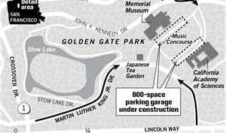
ND11 – Placing New Parking Lots
Reduce Transmission Pipeline Risk through Design and Location of New Parking Lots and Parking Structures

Slide 50
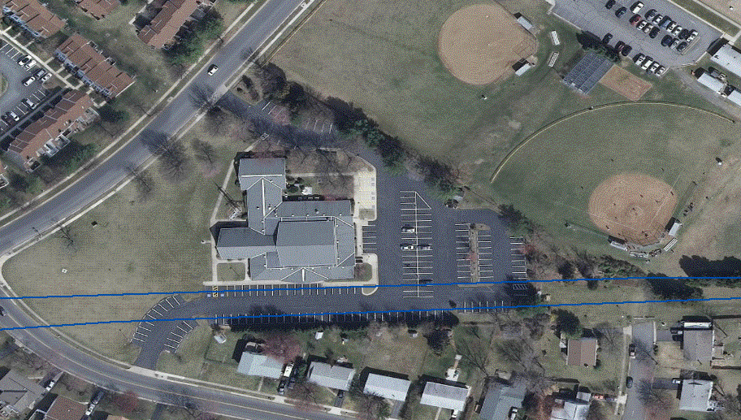
ND22 Reduce Transmission Pipeline Risk through Design and Location of New Places of Mass Public Assembly
…Evacuation routes should…have a safe means of egress with exits located where they would not be made inaccessible by the impacts of a pipeline incident…

Slide 51
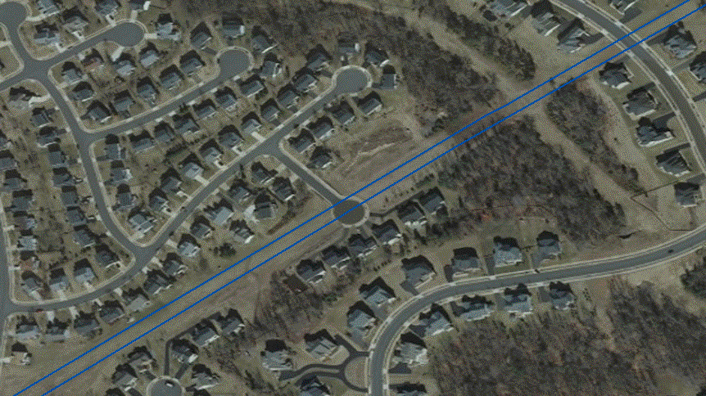
ND17 Reduce Transmission Pipeline Risk in New Development for Residential, Mixed-Use, and Commercial Land Use
…cul-de-sac streets should not be designed crossing a transmission pipeline as the only route of ingress or egress…

Slide 52
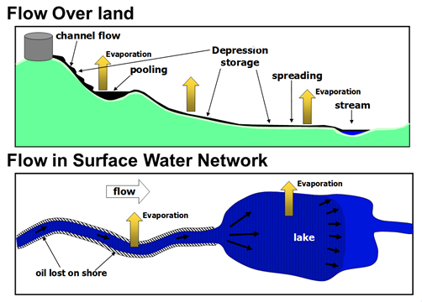
ND17 Reduce Transmission Pipeline Risk in New Development for Residential, Mixed-Use, and Commercial Land Use
Consider:
Locate structures away from ROW
Design alternate escape routes
Require more stringent fire protection e.g. automatic sprinklers, water screens, air handling/ventilation systems) and fire endurance (e.g. non-combustible construction, window limitation)
Avoid interference with pipeline operations and maintenance
Allow access for emergency response
Model fire, explosion, or toxic release impacts

Slide 53
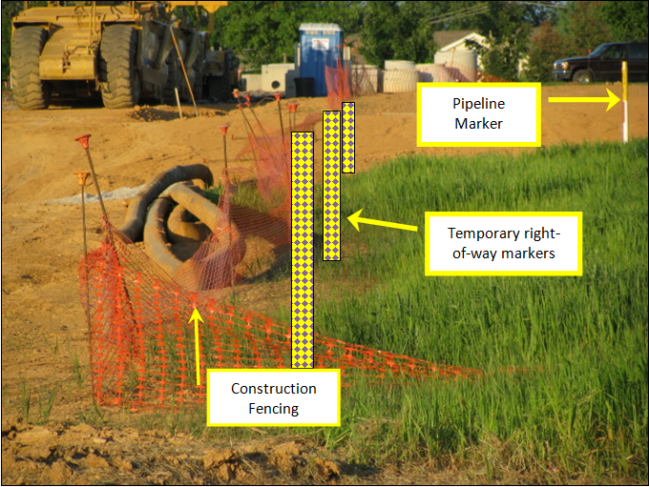
ND24 Temporary Markers for Construction
Install Temporary Markers on
Edge of Transmission Pipeline Right-of-Way
Prior to Construction Adjacent to Right-of-Way

Slide 54
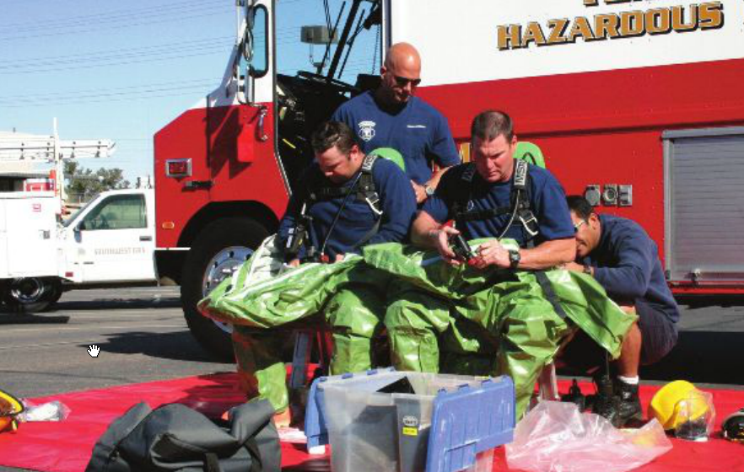
ND 23 Consider Site Emergency Response Plans in Land Use Development
Access to shutoff valves
Access for emergency response personnel/equipment
Location/capacity of water supply/fire hydrants
Potential ICS, triage, and staging areas
…review of existing ROW can illustrate the benefit of land planning practices & identify locations for enhance emergency preparedness…

Slide 55
Local Government Role & PHMSA Support ~ Emergency Response ~ Excavation Damage Prevention

Slide 56
Emergency Response – Where We Are
Communities and their emergency responders are not always aware of pipeline safety concerns. Some reasons include:
Catastrophic pipeline incidents are low-frequency, high-consequence events
Pipelines are out of sight, out of mind
PHMSA requires pipeline operators to communicate directly with the emergency responders regarding safe and effective pipeline emergency response
This communication is essential and part of a larger approach to preparing emergency responders for pipeline emergencies

Slide 57
Where We’re Going
Goal: Reduce the consequences of pipeline failures by strengthening the capabilities of local emergency responders through institutionalizing pipeline awareness within the emergency response community.
PHMSA has undertaken a variety of initiatives and activities to assist with accomplishing the goal:
Educating ourselves and the ER community by hosting/participating in pipeline ER forums
Building partnerships and coordinating with pipeline ER stakeholders
Actively communicating with the ER community via presentations at conferences and articles in trade publications
Creating/enhancing pipeline ER resources

Slide 58
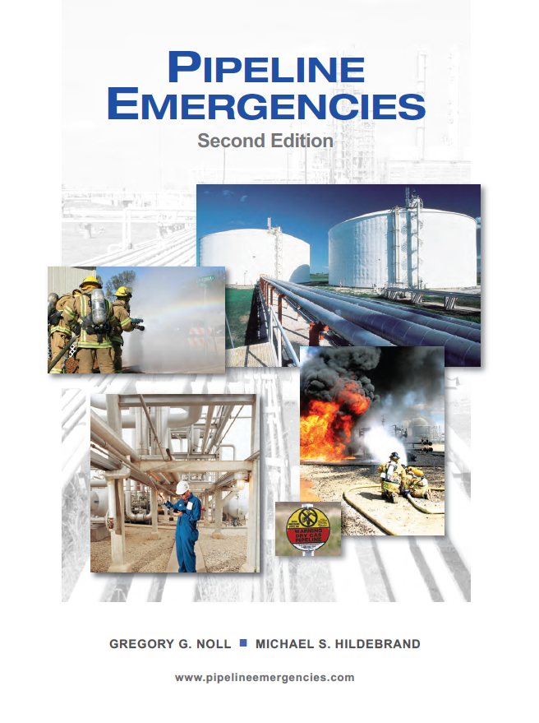
PHMSA Pipeline Emergency Response Resources
Pipeline Emergencies training curriculum – www.pipelineemergencies.com
Emergency Response Guidebook (ERG) – updated and expanded pipeline pages
Hazardous Materials Cooperative Research Program – HM15

Slide 59
More Information
Visit our website at http://opsweb.phmsa.dot.gov/pipelineforum/ pipeline_emergency_response_forum/index.html
Contact Sam Hall Phone: 804-556-4678 Email: sam.hall@dot.gov

Slide 60
Focus on Damage Prevention: What we know
Excavation damage is a serious threat to public safety and pipeline integrity
Data indicates overall decrease in incidents caused by excavation damage, but still a serious threat
Excavation damage is largely preventable
All states have one call laws, one call centers, but state laws and programs vary considerably
More work to do, more support needed

Slide 61
20-Year Serious Incidents*
* Serious Incidents: Pipeline Release and fatality or injury

Slide 62
Damage Prevention: What we’re doing
Providing Tools to build knowledge across the country
State/local outreach: meetings, letters of support, teleconferences, support of 811, sharing of information
Regulatory actions – enforcement of one call laws
Exemptions – Congressional directives
Grants to states
Partnerships: States, Common Ground Alliance, Public, Trade Associations, Safety Organizations
Seeking to expand outreach/partnerships – local government, agriculture, educators

Slide 63
Questions/Discussion
For more information:
Annmarie Robertson Sam Hall
317-253-1622 804-556-4678
annmarie.robertson@dot.gov sam.hall@dot.gov
Resources (programs, data on pipeline facilities, incidents, enforcement, etc.)
http://www.phmsa.dot.gov/pipeline
http://primis.phmsa.dot.gov/comm/

Slide 64
Hazard Mitigation Planning & Pipelines

Slide 65
VDEM & PHMSA – Hazard Mitigation Plan

Slide 66
Valuation Matrix

Slide 67
North Dakota Multi-Hazard Mitigation Plan

Slide 68
Resources for Local Governments

Slide 69
PIPA Online Resources PIPA-info.com
Information about National Pipeline Risk
Notes:
69

Slide 70
Land Use & Development near Transmission Pipelines Checklist
Similar to an Environmental Assessment Checklist
Can Be Used to:
Facilitate Communication
Inform Land Acquisition
Guide Pre-Planning &Design
Permit & Site Plan Review

Slide 71
PIPA RP Evaluation Worksheet for Local Governments
Perform a gap analyses comparing your community’s current practices to the PIPA recommended practices.

Slide 72
Examples of Land Use Ordinances
PIPA Model Ordinance – Appendix B in the PIPA Report
Municipal Research and Services Center of Washington
http://www.mrsc.org/subjects/pubsafe/transpipeords.aspx

Slide 73
PIPA Promotional Material

Slide 74
US DOT PHMSA Technical Assistance Grants
Purpose: to make grants to local communities and organizations for technical assistance related to pipeline safety issues (includes implementing PIPA RPs & enhancing hazard mitigation plans to incorporate pipelines)
Annual grants posted in January and awarded in September
Sign up for alerts when the solicitation is posted on http://www.grants.gov
CFDA number 20.710
Funding number DTPH56-12-SN-000001

Slide 75
http://primis.phmsa.dot.gov/tag
View Previously Awarded TAG Reports

Slide 77
Next Steps for Local Governments
Locate pipelines in you jurisdiction (NPMS)
Read the PIPA Report & Tools
Assess your communities level of risk tolerance for land use/development near pipelines
Put a plan in place to address your community’s needs using PIPA recommended practices
Consider pipelines in your hazard mitigation plan
Contact the pipeline operators in your area to inform them of the actions

Slide 78
Questions?

Slide 79
AICP #e.22486 or ILG Credits
Please visit the Certification Maintenance section of APA’s website (www.planning.org/cm) to claim your credits; you may use the following steps:
(1) Login using your ID# and password.
(2) Select My CM log
(3) Select Add Credits
(4) Under Browse you have the option of searching by Date, Provider, or Distance Education and using the search box to type in the name of the event or activity and clicking go
(5) If you search Activities by Date, on the left of the calendar view, please use the “previous” and “next” options to locate the month. On the right of the calendar view, please use the “previous” and “next” options to select the year
(6) If searching Activities by Provider, using the letters, please select the initial of the first name of the provider. From the list, then select the name of the provider
(7) Select the “Past Events” tab to locate the event you have attended
(8) If searching Distance Education, after selecting, you will see a list of all distance education activities. To select, click on the name of the activity
(9) A pop-up box will appear.
(10) Please rate, add a comment (optional), and click on the Ethics statement and answer
(11) Click submit and the CM credits should appear in your CM log
If you have problems reporting your CM credits or have general questions about our CM program, please contact AICPCM@planning.org. APA’s customer service associates are available to assist you.
No forms to complete if registered (if not registered, contact Jeff Eslinger at (800) 932-8730 or register online www.PIPA-Info.com then click on the link JANUARY 15, 2013, FOR NORTH DAKOTA)

Slide 80
James Davenport jdavenport@naco.org Program Manager Community Services 202-661-8807 National Association of Counties (NACo)
Thank you for your time and interest in pipeline safety!
Julie Halliday
Julie.Halliday@dot.gov Sr. Program Manager
Program Development 202-366-0287 US DOT PHMSA
PIPA-Info.com npms.phmsa.dot.gov

